Slide 1
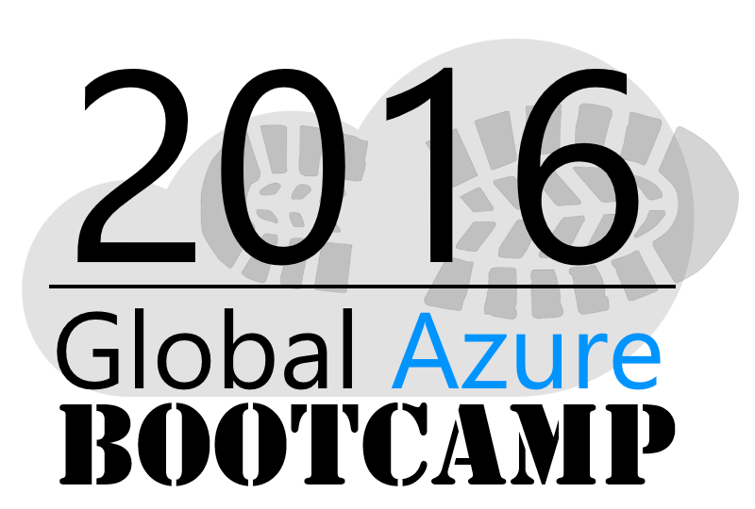
Welcome to the
Copenhagen

Slide 2
Azure Backup & Site Recovery
Jesper Jensen
Twitter: @jefutte / Email: jj@solvoit.com

Slide 3
Azure Backup

Slide 4

When to Choose Windows Azure Backup
Already using System Center Data Protection Manager? Windows Azure Backup integrates easily
System Center
DPM
Protected Server
Small business or branch office? Windows Azure Backup integrates with the in-box Windows Server backup tool
Or
Suitable for any workload
SQL
File Server
Exchange
Notes:
When can you use Windows Azure Backup?
If you’re already using System Center Data Protection Manager, you can start using Windows Azure Backup today – it integrates with System Center Data Protection Manager.
If you’re a small business or branch office and have a small number of servers to protect, Windows Azure Backup integrates with the in-box Windows Server backup tools you may already be using.
Windows Azure Backup is suitable for any workload, file servers, SharePoint®, SQL, Exchange, or others. Windows Azure Backup integrates with Windows Server technologies to make this happen.

Slide 5
When to Choose Windows Azure Backup
Already using System Center Data Protection Manager? Windows Azure Backup integrates easily
Another option is Azure Backup Server (MABS)
System Center
DPM
Protected Server
Small business or branch office? Windows Azure Backup integrates with the in-box Windows Server backup tool
Or
Suitable for any workload
SQL
File Server
Exchange
Notes:
When can you use Windows Azure Backup?
If you’re already using System Center Data Protection Manager, you can start using Windows Azure Backup today – it integrates with System Center Data Protection Manager.
If you’re a small business or branch office and have a small number of servers to protect, Windows Azure Backup integrates with the in-box Windows Server backup tools you may already be using.
Windows Azure Backup is suitable for any workload, file servers, SharePoint®, SQL, Exchange, or others. Windows Azure Backup integrates with Windows Server technologies to make this happen.

Slide 6
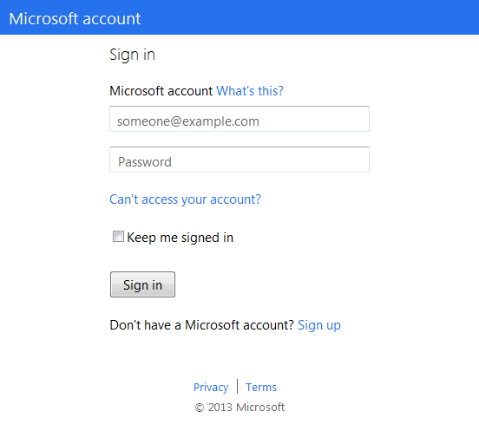
How Windows Azure Backup Works
1. Sign Up
2. Install Agent
3. Register and Configure
4. Backup
Encrypted Data
Window Server 2012
5. Recover - to the same or a different server
Small Business or Branch Office
Notes:
From the previous slide we’ve seen that Windows Azure Backup is suitable for a variety of organizations and workloads. Let’s look at how Windows Azure Backup works in more detail, starting with how to use Windows Azure Backup today in a small business environment or branch office.
As previously mentioned, if you have a small number of servers and you want to protect the data they hold using the built-in tools, the process to configure Windows Azure Backup is relatively simple.
[FIRST CLICK]
First, sign up for a Windows Azure account. This will provide you access to the Windows Azure Management Portal. From there, you can select the Recovery services option and add the Windows Azure Backup service to your account.
[SECOND CLICK]
The next step involves an exchange of data. We’ll cover the certificate part later on in the security section, but for now the important part is the installation of the agent on the server or servers that you want to register to use the Windows Azure Backup service.
[THIRD CLICK]
As mentioned, the Windows Azure Backup agent integrates with the existing Windows Server backup tool. When you start the tool after the agent installation, you register this server using your certificate. Then you configure what data you want to back up and what schedule you want to use.
[FOURTH CLICK]
That is it. So if you are using a schedule, the server will now back up your data to that schedule. You can monitor it from the backup tool, to see when the backup ran, when the next one will run, and view any issues.
[FIFTH CLICK]
If you need to recover data at any time, for example a server failure, or even an accidental deletion of a file or folder from a location being protected, you can use the backup tool to recover that data. Windows Azure Backup provides very granular recovery options, either to the original server or a different one.
Recovering data to an alternative server is a good practice for testing recovery procedures.

Slide 7
How Windows Azure Backup Works
1. Sign Up
2. Install Agent
3. Register and Configure
4. Backup
Encrypted Data
DPM
5. Recover - to the same or a different server
Enterprises with System Center
Notes:
Let’s now look at how Windows Azure Backup works in an environment where you are using System Center Data Protection Manager.
Most of this procedure is the same as we’ve just seen.
[FIRST CLICK]
First, sign up for a Windows Azure account as we talked about in the previous slide.
[SECOND CLICK]
The next step involves installing the agent on the DPM server, not, as in the previous example onto the server you want to protect.
[THIRD CLICK]
The Windows Azure Backup agent integrates with DPM. When you restart DPM after the tool has been installed, you register this server using your certificate. Then you configure what data you want to back up and what schedule you want to use.
[FOURTH CLICK]
The DPM server will continue to protect the existing server as it did before the agent was installed, but the server will now back up data from servers you have configured.
[FIFTH CLICK]
If you need to recover data at any time, for example a server failure, or even an accidental deletion of a file or folder from a location being protected, you can use DPM to recover that data, while still continuing to monitor and protect the other servers.

Slide 8



Security
Only you have your key
Protect your key
Data cannot be recovered without your key
Microsoft does not have your key
… and remains encrypted while stored
… so the data is encrypted on the network…
Data is encrypted on-premises…
Notes:
[First Click]
The first stage in the transfer process is the encryption of your data on premise using your key.
[Second Click]
Your data stays encrypted with your key while in transit over the wire to Windows Azure storage.
[Third Click]
Your data stays encrypted while in Windows Azure storage. It is never decrypted while it resides in Windows Azure storage.
Your data can only be decrypted once it’s restored on your premises. Only you have the decryption key to do this.
This makes it very important to protect this key. Make sure you back up your key, keep it safe, and store a copy offsite. Your data cannot be decrypted without it. In the event of key loss, Microsoft cannot help you as Microsoft does not keep a copy of your key and has no access to it. The key is never passed to Windows Azure during any Windows Azure backup.

Slide 9
Azure Site Recovery

Slide 10


Azure Site Recovery
One solution for multiple infrastructures
Replication
Replication
SAN
SAN
Replication
Microsoft Azure
Hyper-V
Hyper-V
Hyper-V
Hyper-V
Hyper-V
1
Hyper-V to Hyper-V (on-premises)
2
Hyper-V to Hyper-V (on-premises)
3
Hyper-V to Microsoft Azure
Replication
Replication
Microsoft Azure
VMware/Physical
VMware
VMware/Physical
4
VMware/Physical to VMware (on-premises)
5
VMware/Physical to Microsoft Azure
Protect important applications by coordinating the replication and recovery of private clouds across sites. Protect your applications to your own second site, a hoster’s site, or even use Microsoft Azure as your disaster recovery site
Notes:
Azure Site Recovery has several options when it comes to deployment.
ASR is a consistent DR solution regardless of source and target, and supports:
Hyper-V 2 Hyper-V
Hyper-V 2 Hyper-V (with SAN)
Hyper-V 2 Azure
Vmware/Physical 2 Vmware
Vmware/Physical 2 Azure

Slide 11
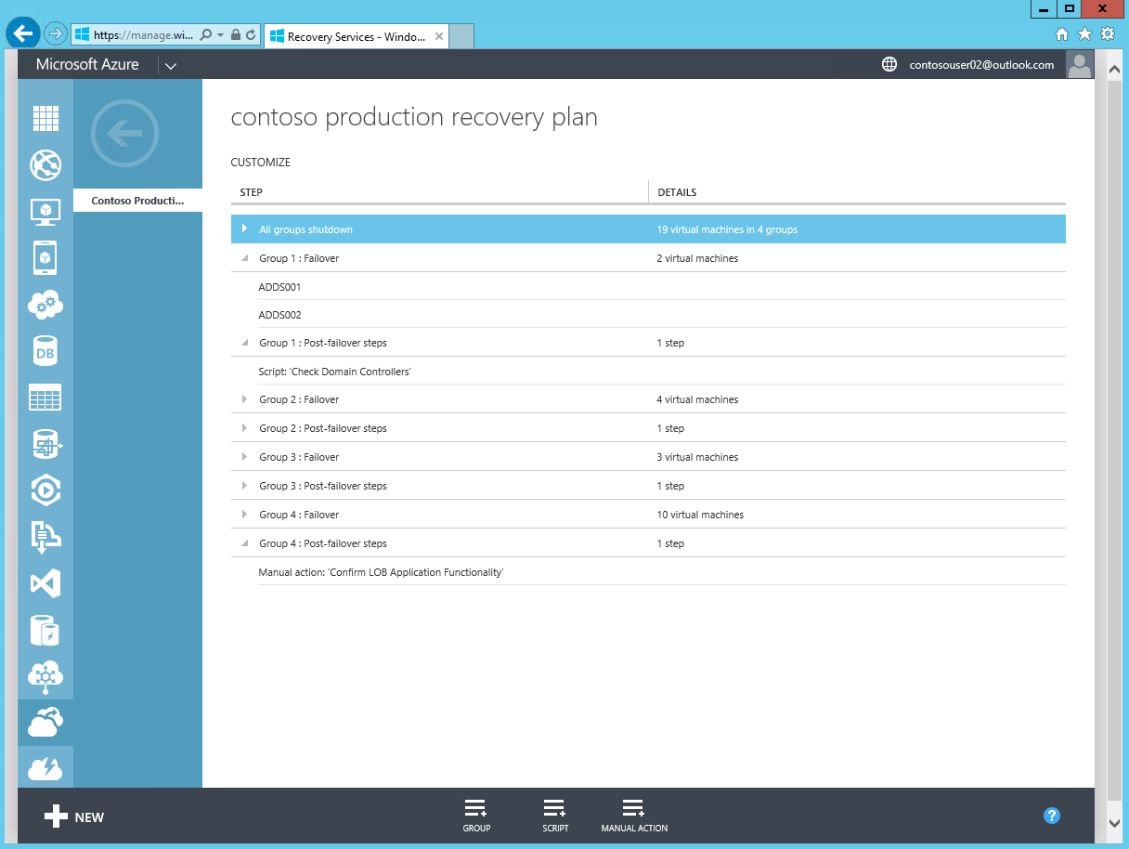
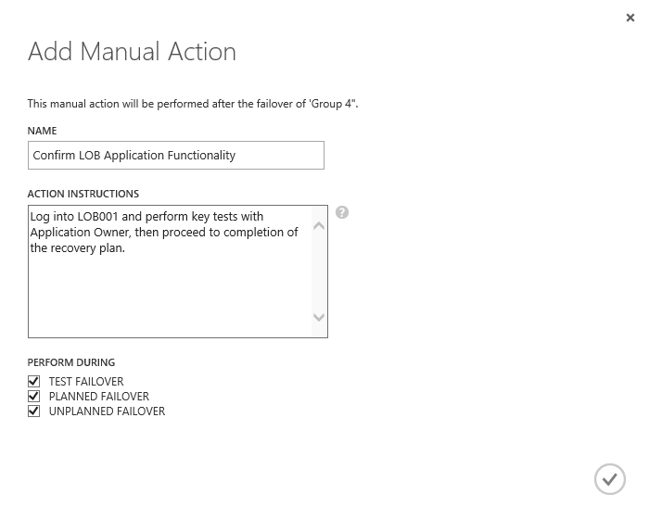
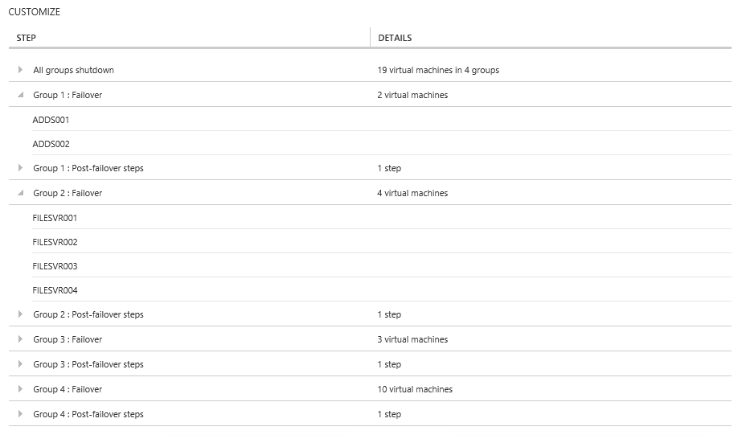
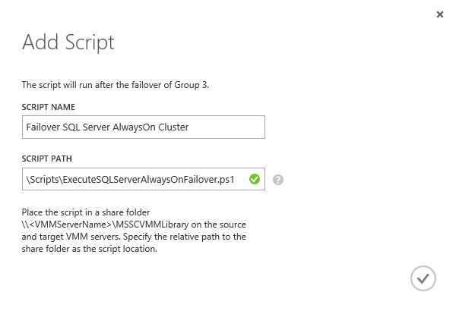
Microsoft Azure Site Recovery
Orchestrated Recovery using Recovery Plans
Orchestrated Steps for Recovery
Recovery Plans help automate the orderly recovery in the event of a site outage at the primary datacenter.
Recovery Plans consist of a series of groups that contain a list of protected virtual machines. The order the VMs failover is determined by the group they are within. VMs within a particular group failover in parallel
Recovery plans typically model an application that needs to start up, or failover, in a particular order.
Script Integration
Scripts can be added, to run before or after a specific group in a recovery plan. Scripts could also allow integration with SQL Server AlwaysOn failover between sites.
Manual Actions
Manual actions can also be added, to run before or after a selected group. These require some form of physical interaction by a particular user before recovery plan continues.

Slide 12
Demo: Azure Site Recovery
Notes:
Demo: Provisioning VM
Prerequisites:
A Windows Server 2012 is already provisioned.
Steps:
Open Ibiza portal and click the NEW button at the lower-left corner.
Show the short list of resources. Explain that I can directly create popular resources here such as a Windows Server 2012.
Click on the Everything link.
In Gallery blade, open the Virtual machines category.
Scroll down the view and show images of different types (refer back to slide 9).
Click on Windows Server 2012 R2, and then click the Create button in the overview blade. For non-Microsoft focused audience, consider to pick a Linux image instead.
Fill in the Create VM form and click on the Create button to provision the VM. Explain this will take a few minutes.
Open the already provisioned VM.
Scroll down the blade to show various of information available on the blade.
Click on the Extensions tile.
On the Extensions blade, click on the ADD icon to bring up the extension list. Introduce that VM extensions are installable components to customize VM instances.
Switch to slides to continue with VM extension introduction.

Slide 13





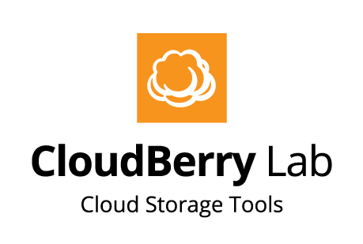






2015 Global Sponsors
Make sure to ask the organizers for the “Stuff We All Get” information!
Notes:
HUSK FROKOST SPONSOR!!!
Vision Solutions + Microsoft
Vision Solutions har desuden doneret nogle gadgets – men husk der skal være til alle!

